Slide 1



Blockchain Based Real Estate Management System
PAVAN KALAM
16358242

Slide 2

Motivation and Problem
This TokenLand project was inspired by the challenges in traditional real estate transactions which includes, -> high costs -> lack of transparency -> limited accessibility for global investors
By utilizing blockchain technology, Real estate properties can be treated as tokenize properties as NFTs, to maintain secure ownership records and reducing intermediaries and also to achieve real estate investment opportunities for users worldwide.

Slide 3
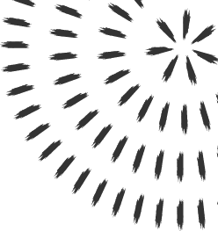
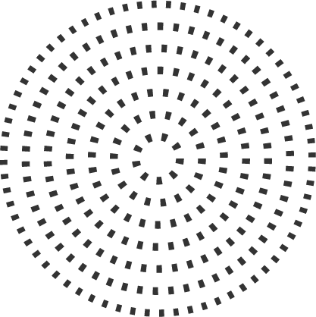
Blockchain Integration
Blockchain technology address to overcome below issues,
To provide immutable and transparent property ownership records
To enable fractional ownership through tokenization
To Reducing intermediaries
To Facilitating global accessibility and faster transactions, to simplify property trading.

Slide 4

Technical Implementation

Slide 5

System Architecture
Frontend: HTML, JavaScript has used to facilitating wallet connection, to perform minting ,listing, buying through the interface and displaying transaction history.
Smart Contract: To tokenize the properties as NFT, also to handle transferring of ownership.
Blockchain: Local Hardhat network for development.
Wallet Integration: MetaMask for secure transactions

Slide 6
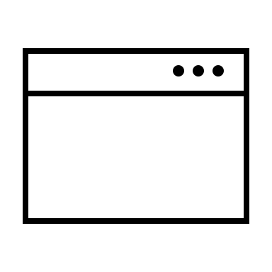
SYSTEM ARCHITECTURE
Browser
TokenLand
User Interface
MetaMask
Local
Hardhat Network
Python
Localhost
Server
Project Files
Coingecko API

Slide 7
Key Components
Admin (Seller) Functionality:
Mint properties as tokens.
List properties for sale.
View transaction history.
Also includes buyer functionalities.
Buyer Functionality:
Browse and purchase properties.
Convert USDT to USD.
Access transaction history.

Slide 8
Core Functions
mintProperty: Allows creating new property tokens with location and price.
listPropertyForSale: Enables property owners to list their tokens for sale.
buyProperty: Allows users to purchase listed properties.
getProperty: Retrieves details of a specific property.

Slide 9
Data Structures
Property struct: Stores information about each property, including location, price, and sale status
Mapping: Links token IDs to Property structs, allowing efficient retrieval of property details.
Token ownership is stored in mappings, i.e., mapping(uint256 => address) to map property IDs to owners.

Slide 10
Algorithms
Property Minting: To creates new property NFTs with specified location and price.
Property Listing: To allows property owners to list their properties for sale.
Property Buying: It facilitates the purchasing of listed properties.
Wallet Connection: To implement secure connection using MetaMask.
Role-based Access Control: Differentiates between seller and buyer roles for specific functionalities

Slide 11

Demo

Slide 12
Conclusion
Involvement of blockchain in real estate reduces the involvement of intermediates, lowering costs and increasing efficiency.
Integration of user authentication and transaction handling using MetaMask is a significant contribution to the TokenLand functionality.
Planned in future to introduce AI-powered property valuation for real-time pricing.

